Slide 1
How
to
Think ???

Slide 2
1. Introduction
3. Activities
2. What is Thinking?
7. Conclusion
4. Types of Thinking
Thinking
5. Steps to learn something
6. How to Think ???

Slide 3
Introduction
“Some people study all their life and at their death they have learned everything except to THINK”
– Francois Doumergue

Slide 4

Why is Imagination so Important?
I Need input from you!

Slide 5
What is Thinking?
Why doesn’t SHE like me?
Why doesn’t HE like me?
As you start asking questions and seek answers
you are in fact thinking

Slide 6
Activity 1

Slide 7


Activity 2
1 + 1 = ……

Slide 8
Types of Thinking
The best way to have a good idea
is to have lots of ideas
Analyzing
Evaluating
Creativity
New
Ideas
Vertical
Thinking
Lateral
Thinking

Slide 9






Steps to Learn something
Unable
Unable
Able
Able
Unable
Unconscious
Conscious
Conscious
Unconscious
Able
Conscious
We are here now !!!
Conscious
Able
Unconscious

Slide 10

Activity 3
X
How to Think ???
2-Lateral design
1-Brain Storming
2-Lateral design
Judgement
Activity 4

Slide 11
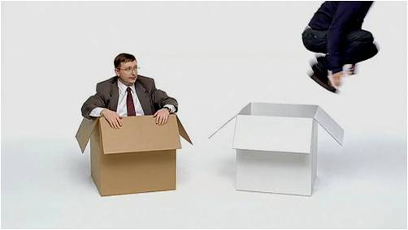
Conclusion
Think out of the Box

Slide 12



Slide 13
Special thanks
  Hassan Beltagy
  Ola Khalil Ibrahim
  Ahmed Refaat

Slide 14


Slide 15
Any Questions ???

Slide 16
References
Dr.Amr Ossman ( Prof. AUC , UFE)
Introduction to critical thinking
( Presentation by Ziad Ali Alsagoof )
Creative thinking
( Presentation by Prof. P. Madar Valli)

Slide 17
How
to
Think ???
Ahmad Hegazy

